Slide 2




1. Brand assets – TISS Incube, TISS & BMCWS logos + any brand guidelines
TIF Jpeg file
TIF png file

Slide 3
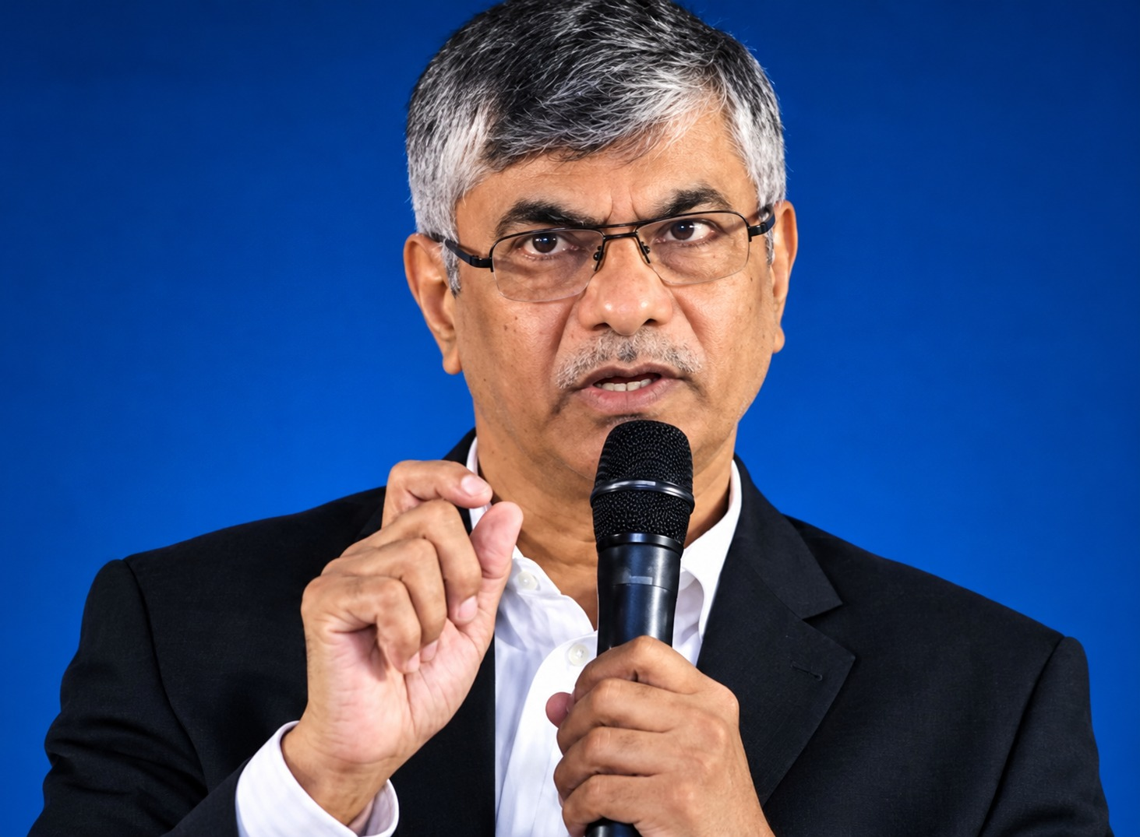



2. Photos – High-quality photos of team, founders, field visits, workshops, events, communities, etc.
TIF Leadership Team
Prof Satyajit Majumdar
Managing Director, TIF
Ex- Professor and Dean – School of Management and Labour Studies,
Tata Institute of Social Sciences, Mumbai

Slide 4
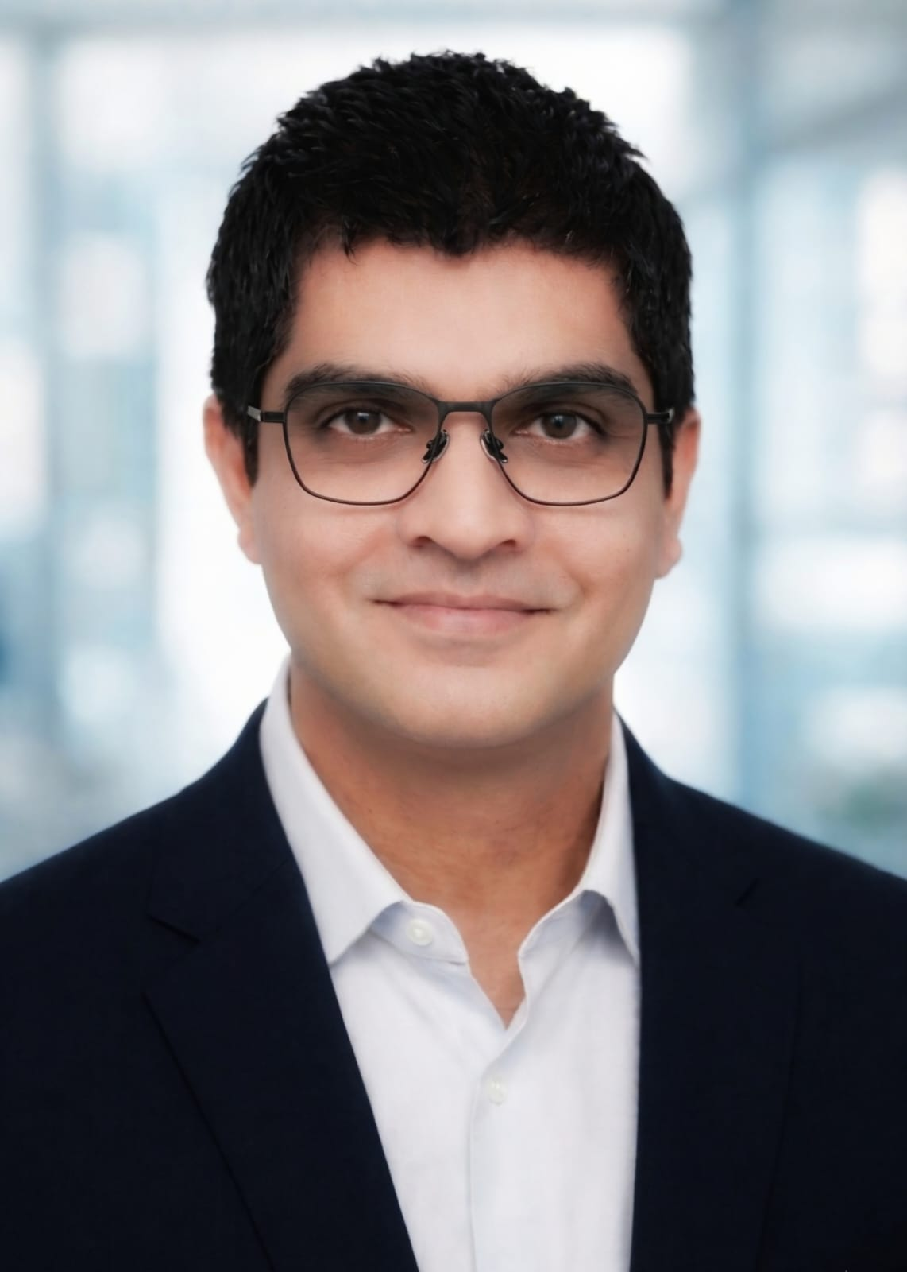






2. Photos – High-quality photos of team, founders, field visits, workshops, events, communities, etc.
TIF Leadership Team
Sujay Dixit
CEO, TIF
Ex- Unilever, Glenmark Pharma, Hindustan Coca Cola Beverages Pvt Ltd., Celio

Slide 5



2. Photos – High-quality photos of team, founders, field visits, workshops, events, communities, etc.
Board of Directors
Dr. Vipin Kumar
Chief Scientist, National Innovation Foundation

Slide 6


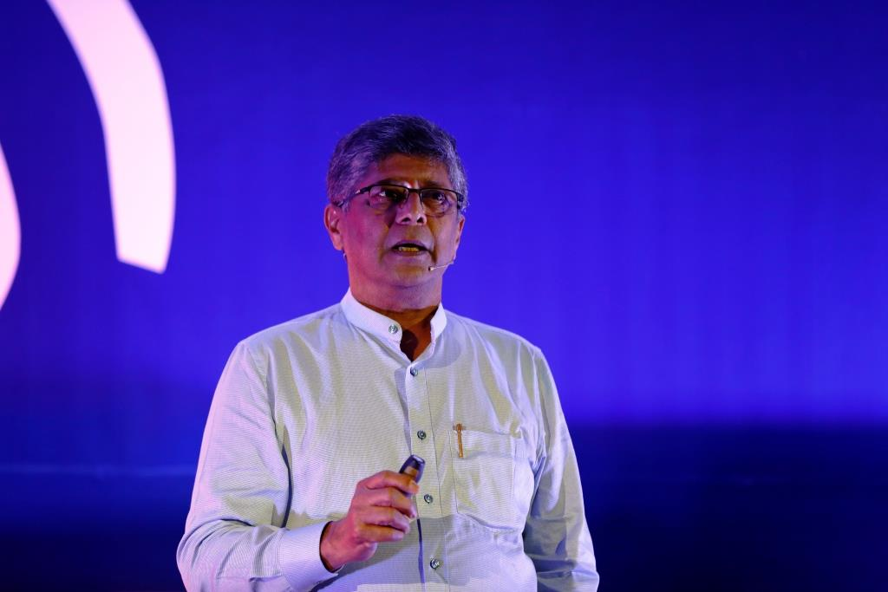

2. Photos – High-quality photos of team, founders, field visits, workshops, events, communities, etc.
Board of Directors
Dr. Madhav Sathe
Anaesthesiologist – Bombay Hospital, Breach Candy Hospital
Secretary – BMCWS
Visiting Faculty – TISS Mumbai
University of Mumbai

Slide 7
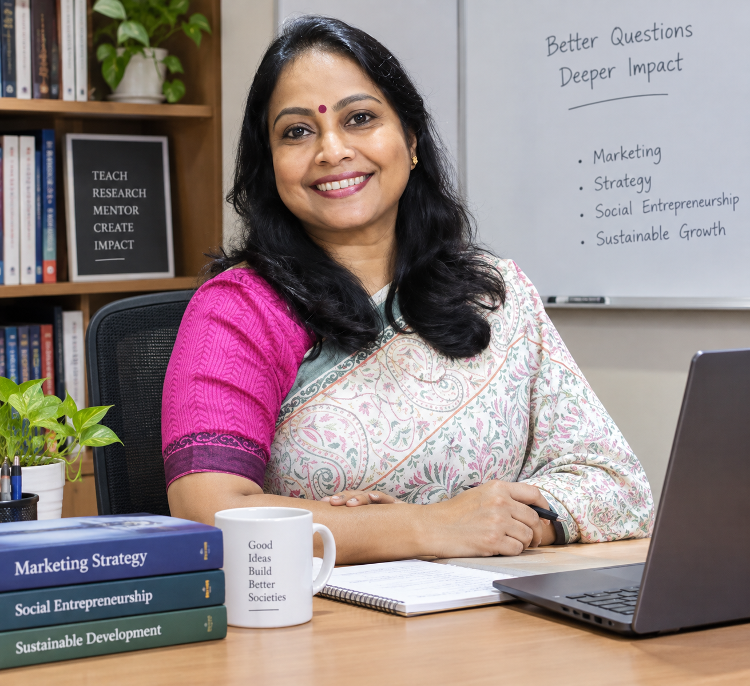
2. Photos – High-quality photos of team, founders, field visits, workshops, events, communities, etc.
Board of Directors
Dr. Archana Singh
Asst Professor- TISS Mumbai

Slide 8
Impact numbers – Latest verified figures for ventures, locations/districts, mentors, livelihoods, etc
Impact layer | Estimate
Entrepreneurs / founders | 400+
Immediate families of entrepreneurs | 1,200–2,000
Employees / workers of supported enterprises | 2,000–4,000
Employee families & dependents | 10,000–20,000
Suppliers, producers, artisans, farmers & value-chain partners | 80,000–1,60,000
Customers / users / community members directly reached by enterprises* | 1,00,67,000
Estimated cumulative lives impacted | 1,02,51,000 (>10 Million)

Slide 9
Impact numbers – Latest verified figures for ventures, locations/districts, mentors, livelihoods, etc
* Estimated Impact Reach of Customers / users / community members directly reached by enterprises
Enterprise Tier | Adjusted Percentage Split | Count | Avg. Unique Annual Reach per Enterprise | Average Lifespan under TIF Window | Total Cumulative Tier Reach
Nano Enterprises | 42.11% | 168 | 250 | 7 Years | 294,000
Micro Enterprises | 36.84% | 148 | 1,500 | 7 Years | 1,554,000
Small Enterprises | 21.05% | 84 | 15,000 | 7 Years | 8,820,000
Total Portfolio | 100% | 400 | — | — | ~10.67 Million

Slide 10
. Ventures – Venture names, founder details, sector, short description, impact + photos/logos
Included in a Word File shared with this presentation

Slide 11
Partners – Official partner list + logos
Following Section Covers this

Slide 12








Partners – Official partner list + logos
Expert Consultation to world renowned bodies
Expert Advise to key GOI departments
Major Outreach Programme with leading govt bodies & Ministry
TIF Presence & Key Highlights

Slide 13


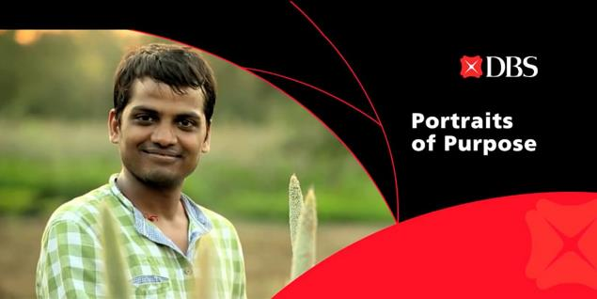


2012 – Partnership with DBS
Supported 41 enterprises
Provided Mentoring and Funding Support for 36 months
Managed total funds of INR 5 Cr

Slide 14

2012: SRREOSHI : Durgapur
Training & mentoring
Incubating the Incubator
Focused on marginalised Tribal Women entrepreneurs

Slide 15

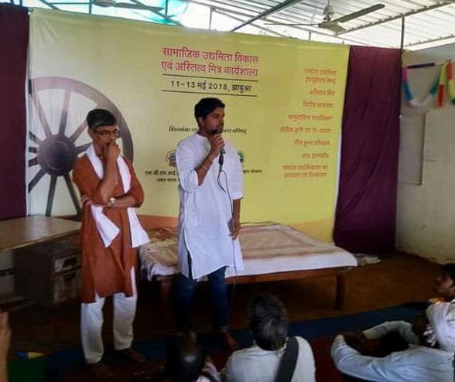

2014: Shivganga Samgra Grameen Vikas Parishad- Jhabua
Impetus on entrepreneurship as means of social reform
Deep engagement with farmers and youth
Interventions led to development of two verticals –
  Jhabua Naturals: Organic Vegetable supply to towns in the vicinity
  Jhabua Craft: Artifacts made out of bamboo

Slide 16
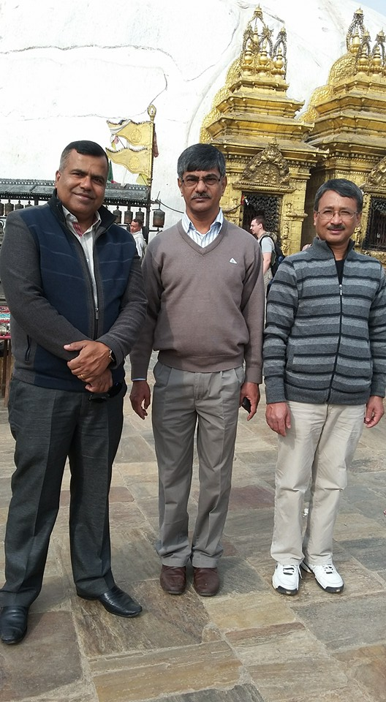
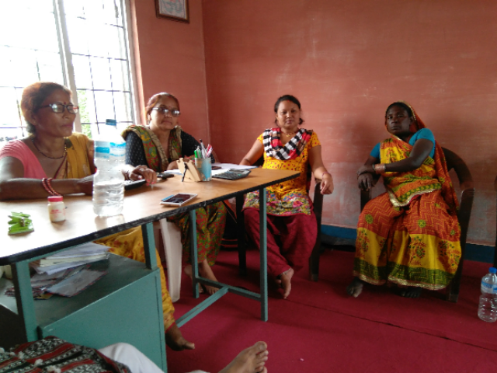
2014: Kathmandu & Janakpur - Nepal
Capacity building of NGO partners
Small Business Support Programme
Training and Mentoring young entrepreneurs to run micro-enterprises

Slide 17
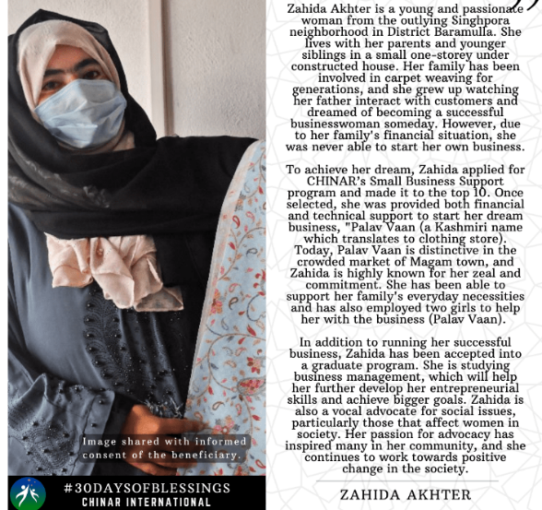
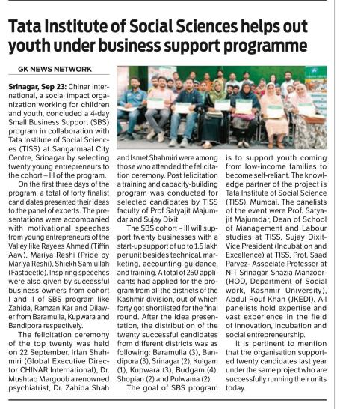
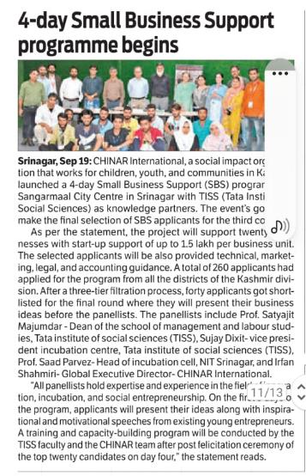

2016: Small Business Support Programme – Kashmir Valley
Unique programme focussed on marginalised youth in Kashmir Valley
Engaged in training and mentoring young entrepreneurs
Supporting >100 micro-enterprises and counting

Slide 18
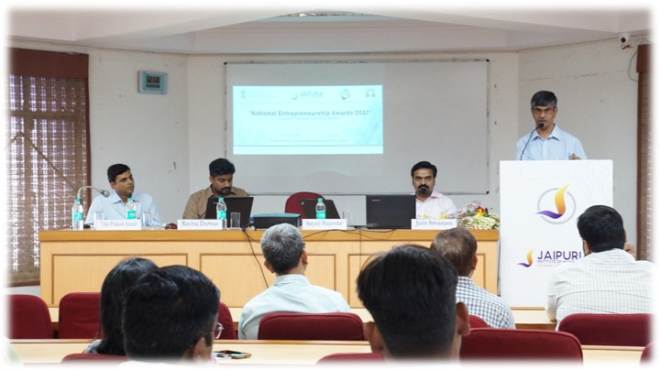


2017 – National Entrepreneurship Award Lead Partner – Ministry of Skill Development & Entrepreneurship
Successfully Led the National Entrepreneurship Award
Streamlined Award Process
Managed a budget of INR 3 Cr
Continued to be core committee member

Slide 19
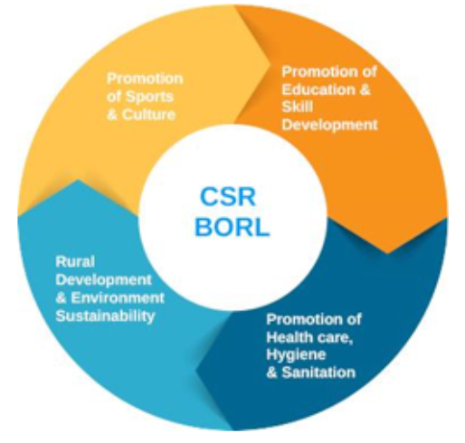

2017 – Impact Assessment Study: BORL
Detailed study done on the CSR initiatives undertaken by BORL in Bina region
Covered 22 villages across four themes –
  Sports & Culture
  Education and Skill Development
  Healthcare, Hygiene and Sanitation
  Rural Development & Environmental Sustainability
Provided a strategic CSR framework for future actions

Slide 20
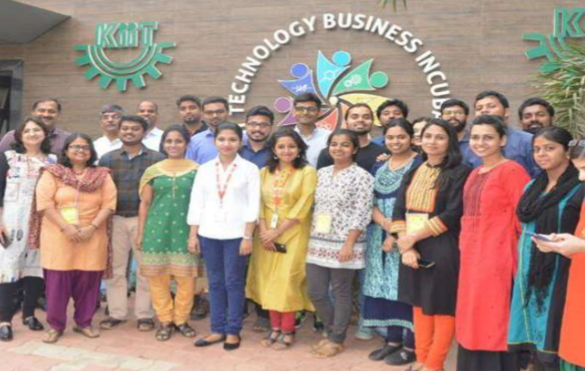

2018 – Official Knowledge Partner – BIRAC
Official Knowledge Partner to SPARSH SIIP Programme
Supported 15 Tech Innovators

Slide 21
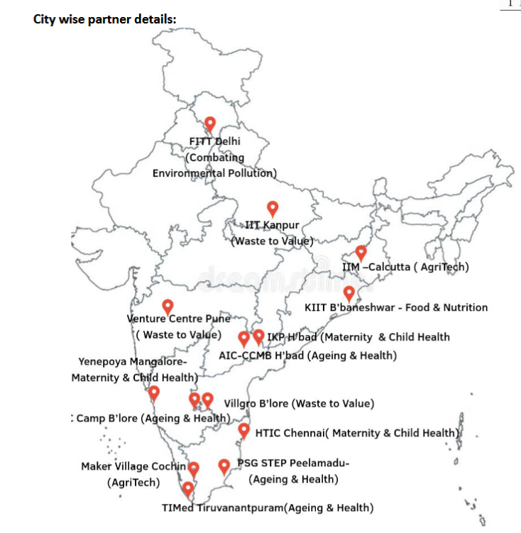
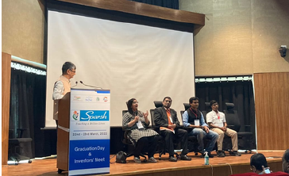
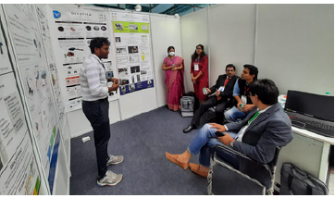
2019 – Scaling up of SPARSH Programme
Official Knowledge Partner to scaled up version of SPARSH SIIP Programme
No of TBI partners scaled up from 4 to 14
Supported 2 cohorts of 70 Tech Innovators each
Created process layout
Regular Workshops and Trainings
Monthly reviews with all 70 Fellows
Quarterly Field visits

Slide 22
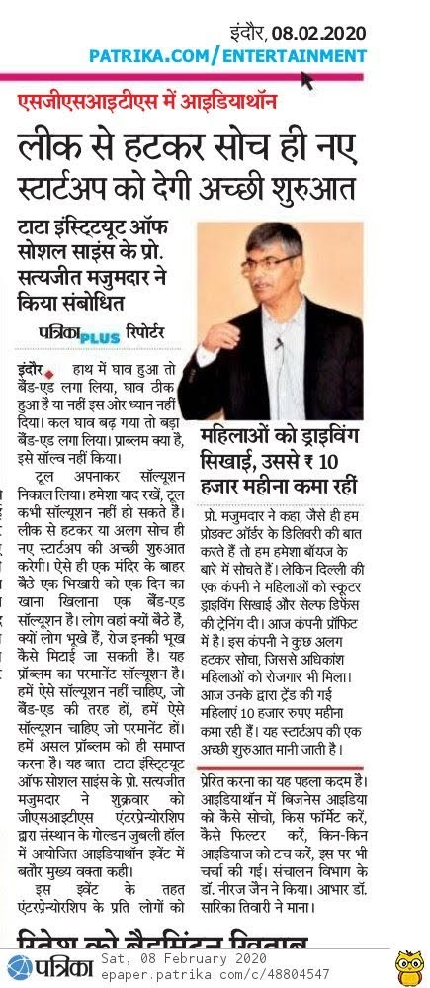

2019: SGSITS Incubation Forum
Idea conceptualization
Programme Design
Mentoring the core team
Joint Programme

Slide 23
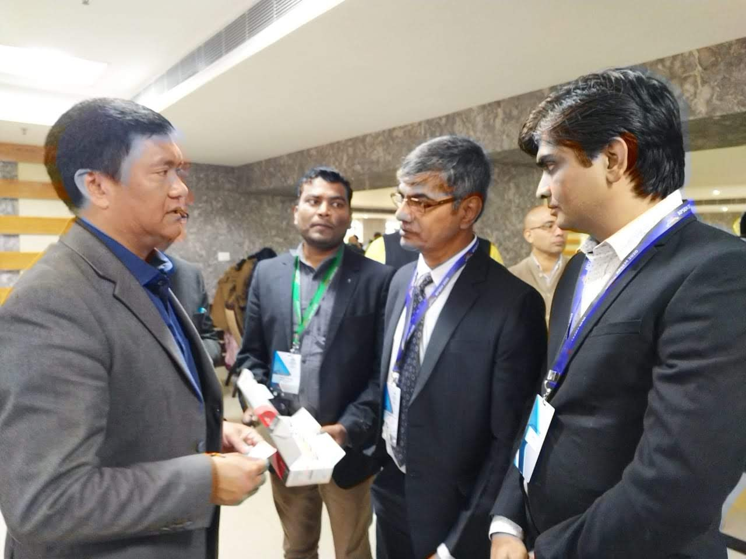
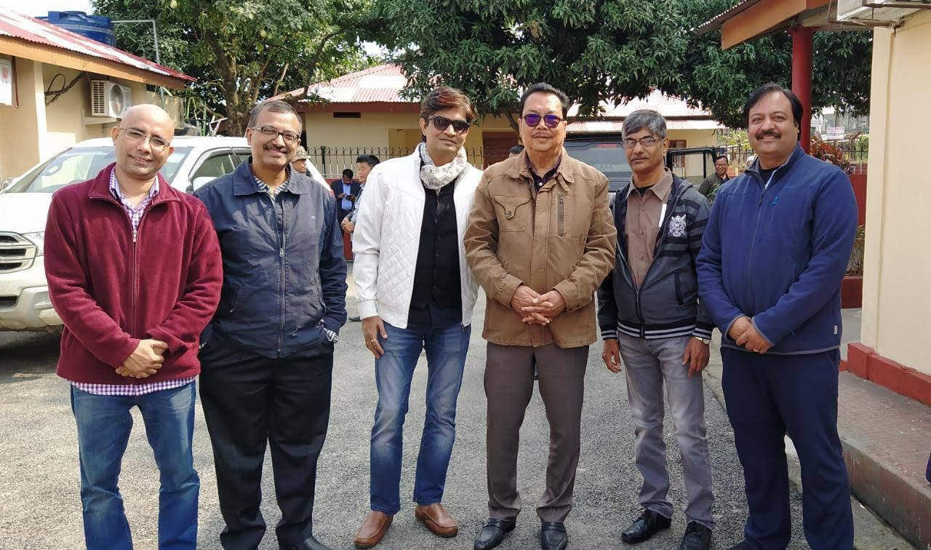
2019-20: Engagement with Arunachal Pradesh Government
Conceptualization
Programme design support
Mentoring
Incubation Calls

Slide 24


2020: Impact Assessment Study : NCST
Assessing the effectiveness of Govt Initiative during COVID in tribal districts of MP, Chattisgarh, and Maharashtra
  Research Design
  On-field data collection
  Analytics
  Recommendations
Focus on the following Areas –
  Food
  Health
  Livelihood
  Education

Slide 25
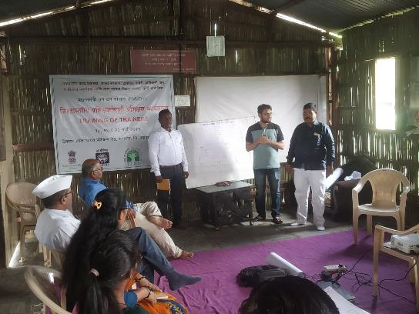
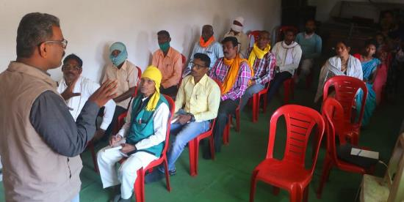
2020: PMVDY ESDP
Implemented the PMVDY-ESDP programme in state of Maharashtra
Focus on training and mentoring of tribal population
Mentoring VDVK’s for enterprise creation

Slide 26
2021: Samanvay Mandapam: Agri-Entrepreneurship Programme for Grassroot: Bina
Addressing the issue of youth unemployment in rural areas
Formalising agri-related occupations into a profession

Slide 27
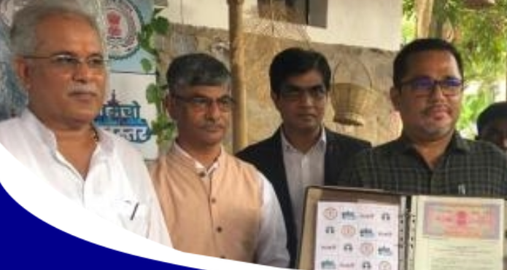
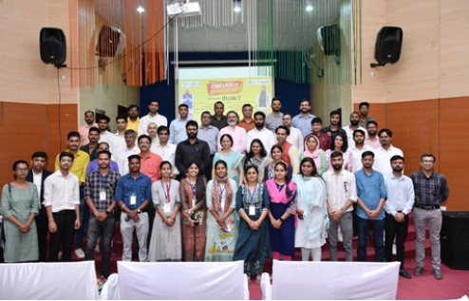
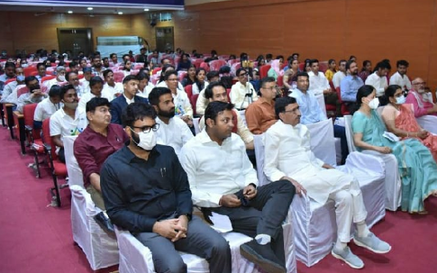

2021 – Official Knowledge Partner of THINK-B
Partnered with Distt Administration of Jagdalpur in Bastar Region of Chattisgarh State
Custodian of the Incubation Support Programme
Supporting > 20 enterprises
Organised first ever Entrepreneurship Conclave in Bastar Region
Attended by Govt Officials, Practicing Entrepreneurs, Industry Experts and Investors.

Slide 28
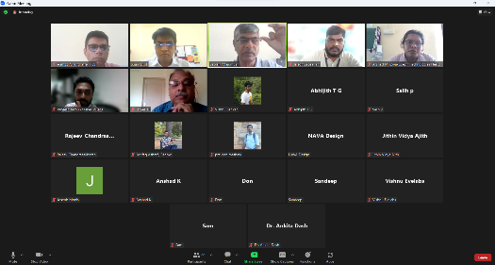
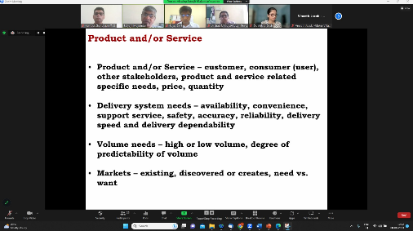

2021: Knowledge Partner Nidhi Accelerator: Maker Village
Supporting 15 enterprises
Focus on finer nuances of enterprise creation
Regular workshops and reviews covering –
  Venture Plan Writing
  Marketing – Customer Identification
  How to approach investment pitch

Slide 29
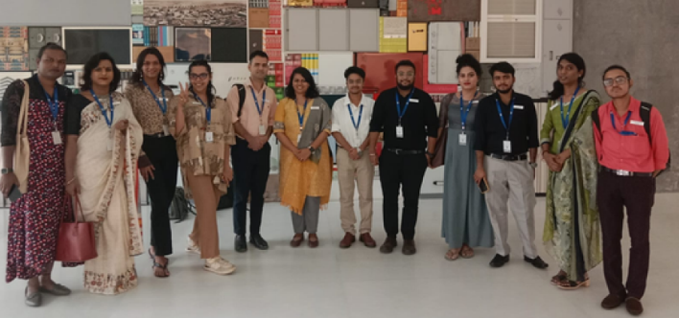







2022 – Transformation Fellowship Programme
Supported 14 Transgender Youth
Programme Focused on Academic Learning, Professional Development, and Career Readiness
2 Fellows pursuing higher education, others are placed or in the process
Internship Placement
Final Placement

Slide 30
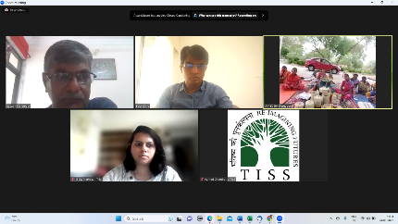
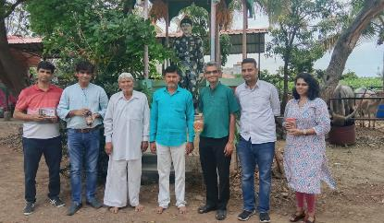
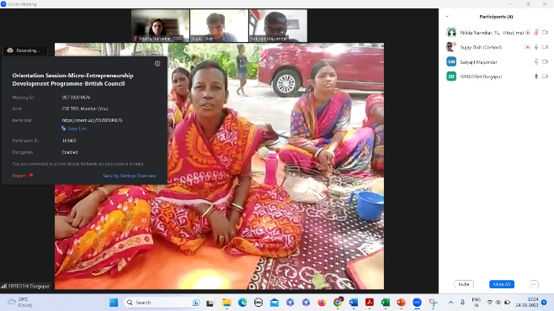



2023: Certificate Programme in Technology-Based Social Entrepreneurship: British Council
Supporting marginalized women in tribal districts of WB, and Pandharpur in Maharashtra
Training and mentoring in creating group enterprises utilizing local resources
The programme will support 50 micro-entrepreneurs in setting up and managing their enterprise
Building international ecosystem
Programme Partners

Slide 31
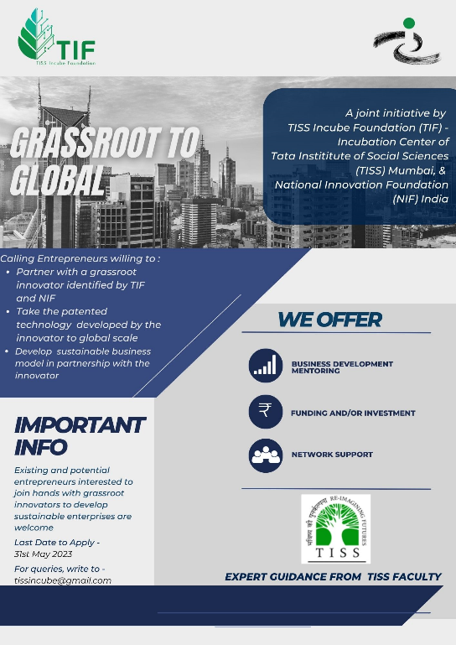

2023: Grassroot To Global: NIF
Getting budding entrepreneurs and NIF innovators together
Mentoring to set up technology based enterprise
  Business Development - Participants will receive training and mentoring on business development
  Funding and/or investment – The enterprises created will receive support in the form of investment, debt or grant

Slide 32
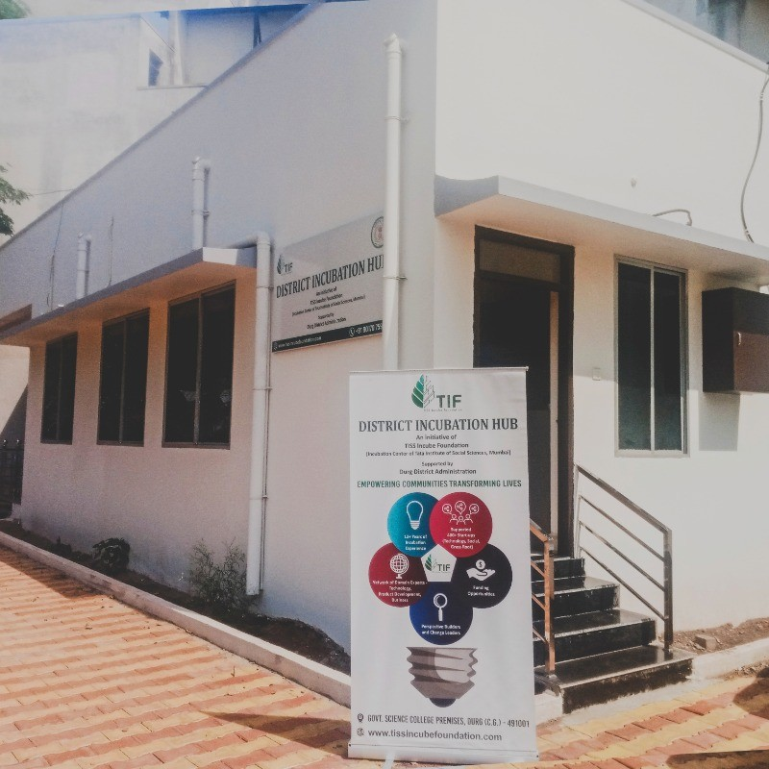
2024: Partnership with District Administration of Durg
Started District Incubation Hub in October 2024 in association with the District Administration of Durg
Incubated >50 enterprises over last 18 months
DIH became the anchor for entrepreneurship ecosystem in the region
Mobilised local HNIs to actively participate in the enterprise creation process
Connected Durg Incubatees to International Network of Mentors
Activated schools and colleges to nurture spirit of entrepreneurship
Organized 3 investor conclaves / Agri-tech summit / Ideathons at regular intervals

Slide 33
Major International Partnership and Collaboration
University of Strathclyde, Glasgow (UK)
Kennesaw State University, Georgia (US)
King’s College, Kathmandu (Nepal)
University of Colombia
Omsk Incubation Center, Siberia Region (Russian Federation)

